Slide 1


Thynk Unlimited
Project
-
Patient Encounter Cost and Risk Analysis in Healthcare Systems
Analysis BY-Nitesh Chandra Jena
Dt-12 Jan 2025

Slide 2
Introduction
Thynk Unlimited
-
Project
-
Health care Organizations are facing challenges managing the costs and financial risks associated with patient encounters
This project mainly aims to analyze the patient encounters, procedure cost and payer coverage to identify the pattern for high healthcare cost and financial risks.
The objective is to support informed decision-making for resource allocation, patient care management, and financial planning.

Slide 3
Tables
Encounters
Organization
Patients
Thynk Unlimited
-
Project
Payers
06
Procedures

Slide 4
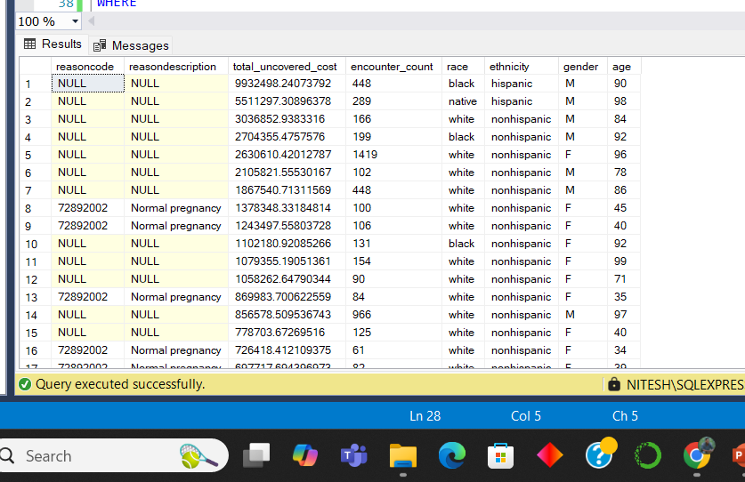
Financial Risk by Encounter Outcome
Objective:
Determine Reason Codes leading to the highest uncovered costs.
Key Insights:
Combining the patient demographics and encounters outcomes to identify key risk factors. Also identified the Reason codes are contributes significantly to the uncovered cost.
01

Slide 5
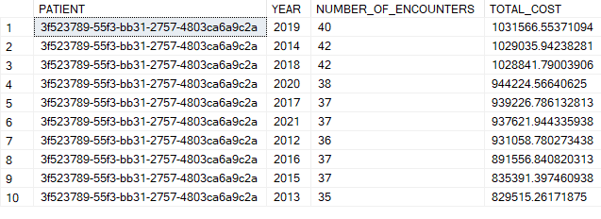
Patients with Frequent High-Cost Encounters
Objective:
Identify patients with more than three encounters per year and high claim costs.
Key Insights:
Top Patient: 3f523789-55f3-bb31-2757-4803ca6a9c2a, contributing over $1M annually for multiple years.
Repeated high costs signal opportunities for targeted care management
02

Slide 6
Risk Factors Based on Demographics and Encounter Reasons
Objective:
Analyze demographic trends linked to high-cost Reason Codes.
Key Insights:
Top Reason Codes: 88805009, 55822004 are most frequent.
Specific patient demographics correlate with recurring high costs.
03

Slide 7
Payer Contributions for Different Procedure
Objective:
Evaluate payer coverage gaps for procedure costs.
Key Insights:
Discrepancy between base costs and claim costs indicates financial risks.
Specific payers consistently underperform in coverage.
04

Slide 8
Patients with Multiple Procedures Across Encounters
Objective:
Analyze cost trends over time and their link to diagnoses.
Key Insights:
Increasing procedure costs highlight rising healthcare expenses.
Correlation between top Reason Codes and high-cost procedures informs resource allocation.
05

Slide 9
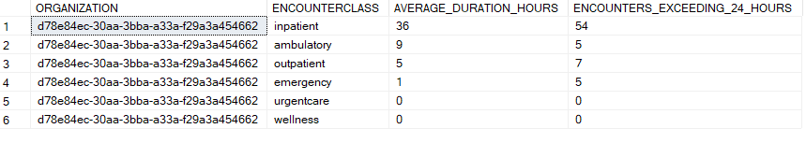
Analyzing Patient Encounter Duration for Different Classes
Objective:
Evaluate average encounter durations by class and flag durations exceeding 24 hours.
Key Insights:
Longest Average Duration: Inpatient encounters (36 hours).
High-duration encounters often exceed operational norms and may indicate inefficiencies. Inpatient encounters (36 hours).
06

Slide 10
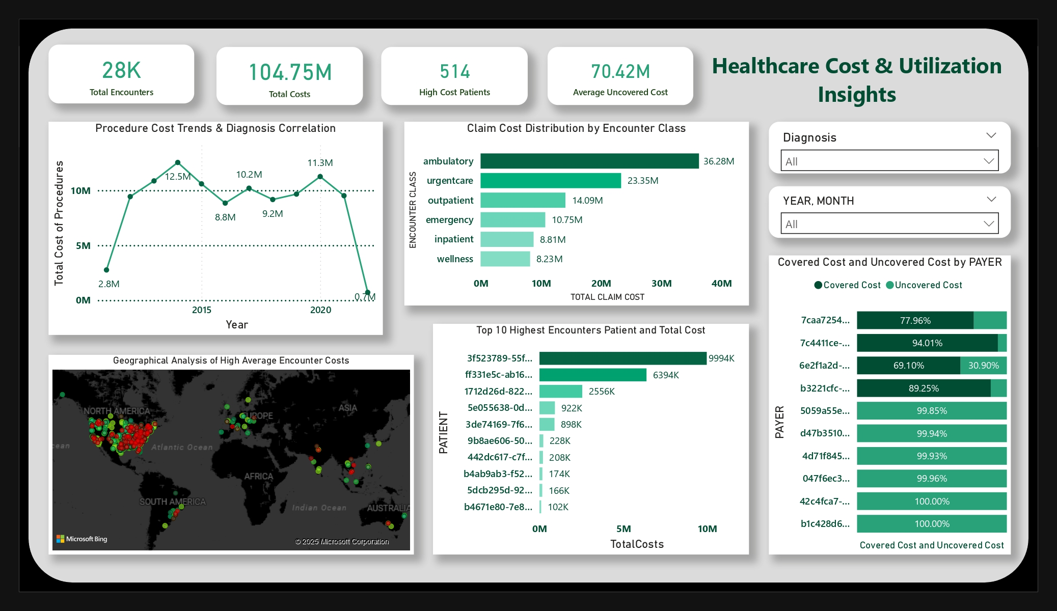
Power BI Visualizations

Slide 11
Conclusion
SQL QUERIES:
Financial risk is concentrated in specific ReasonCodes and patient groups.
Payer contribution gaps present an opportunity for operational optimization.
High-cost patients and prolonged encounters require focused interventions.
Data-driven insights enable strategic improvements in cost management and patient care.
POWER BI REPORT:
Encounter Costs: Emergency and inpatient classes drive the highest costs, visualized with filters for time and payers.
High-Cost Patients: Identified repeated high-cost patients contributing significantly to total expenses, enabling targeted care.
Procedure Trends: Analyzed procedure cost trends and correlations with diagnosis codes for better cost management.
Geographic Insights: Mapped regions and organizations with high patient traffic and costs for resource optimization.
Uncovered Costs: Highlighted financial risks due to uncovered costs across diagnoses, aiding policy and payer strategy.

